Slide 1
Java Server Pages

Slide 2
Introduction to JSP
JSP stands for Java Server Pages.
Used to create dynamic web pages.
Combines HTML and Java code.
Runs on web server like Apache Tomcat.

Slide 3
Static vs Dynamic Web Pages
Static Web Page
Same content for every user
Created using HTML
Dynamic Web Page
Content changes for each user
Created using JSP / PHP / ASP

Slide 4
What is JSP?
JSP is a server-side technology.
Used to build Java web applications
Converts JSP file into Servlet
Executed on the server

Slide 5
JSP Architecture
Client sends request through browser
Web server receives request
JSP file converted to Servlet
Servlet compiled and executed
Response sent to browser

Slide 6
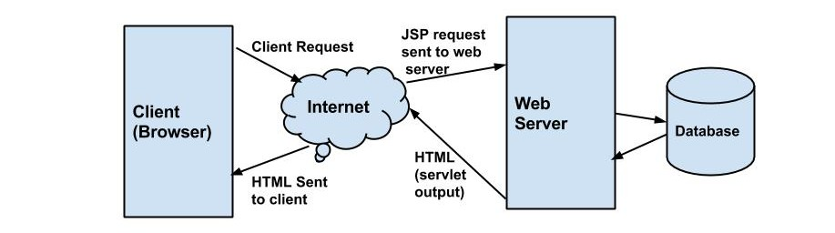

Slide 7
JSP Life Cycle
JSP pages go through several stages before generating a response to the client.
The JSP life cycle consists of five main phases:
1.Translation: The JSP file is translated into a Servlet(.java file) by the web container.

Slide 8
2.Compilation
The generated servlet file is compiled into class file(.class)
3.Initialization
The container calls the jspInit() method to initialize the servlet.
4.Execution/Request Processing
The _jspService() method handles the client request and generates the response.

Slide 9
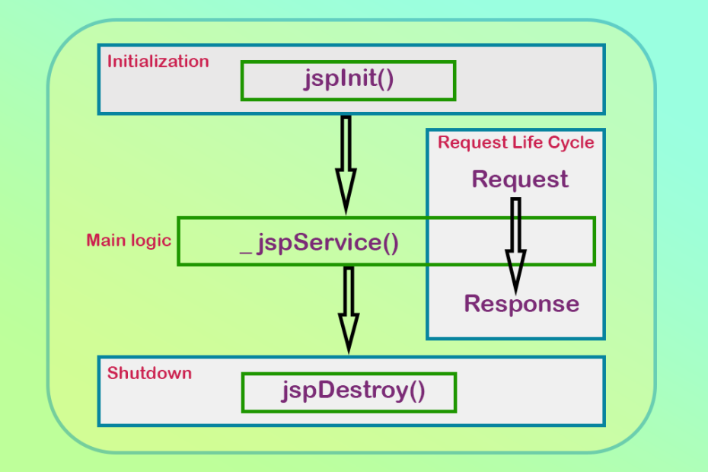
5.Destruction The jspDestroy() method is called when the JSP is removed from service.

Slide 10
JSP Syntax
Scriptlet:
<% Java code %>
Expression:
<%= expression %>
Declaration:
<%! variable or method %>

Slide 11
Advantages Of JSP
Easy to write web pages
Supports Java Programming
Reusable components
Fasted development
Platform Independent

Slide 12
JSP vs Servlet
Servlet
Java code generates HTML
More complex
JSP
HTML with Java code
Easier for designing web pages

